Slide 1
FX sub-workstream (Vnext)
31.01.2024

Slide 2
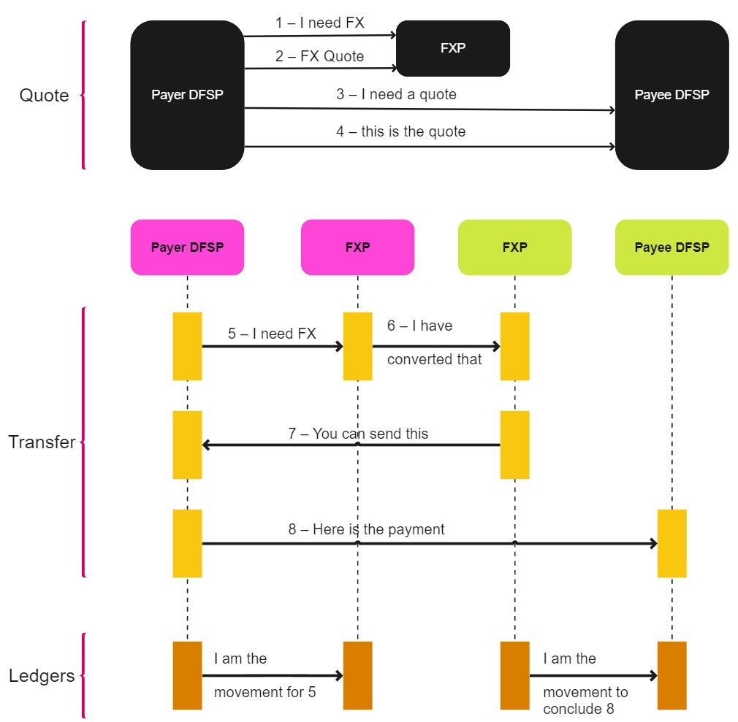
Focus Use Case
Currency conversion is being performed by the payer DFSP
(SEND amount type)
Epic ticket:
https://app.zenhub.com/workspaces/mojaloop-project-59edee71d1407922110cf083/issues/gh/mojaloop/project/3722

Slide 3

Changes to be made in each phases
Discovery Phase
Changes in FSPIOP
Account Lookup & Discovery BC
Currency Conversion Phase
Changes in FSPIOP
Account Lookup & Discovery BC
Participant Lifecycle Management BC
Changes in UI
Agreement Phase
Changes in FSPIOP
Changes in existing BC (Quoting BC, Account and Balance BC)
Adding new Currency Conversion BC
Transfer Phase
Changes in FSPIOP
Changes in existing BC
See Sub-Workstream Update in here

Slide 4
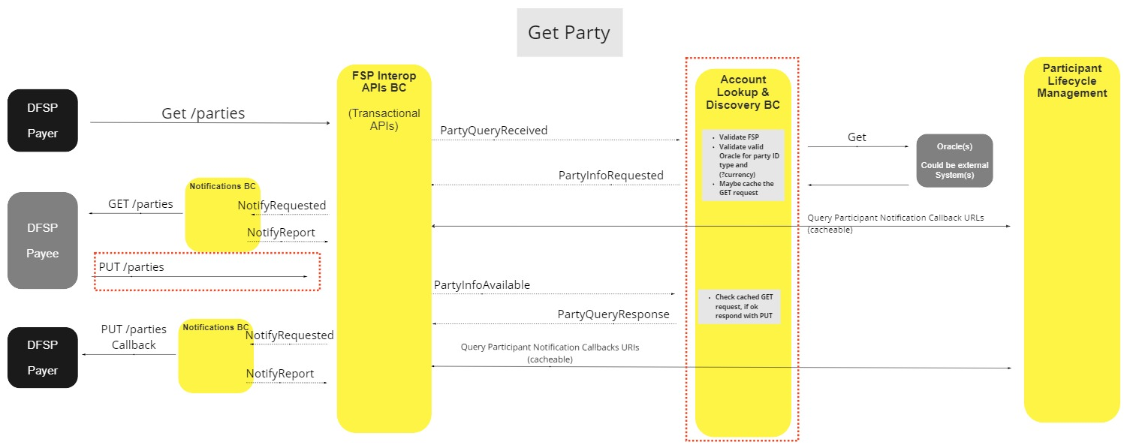
Discovery Phase
Backlog: https://app.zenhub.com/workspaces/mojaloop-project-59edee71d1407922110cf083/issues/gh/mojaloop/project/3723

Slide 5
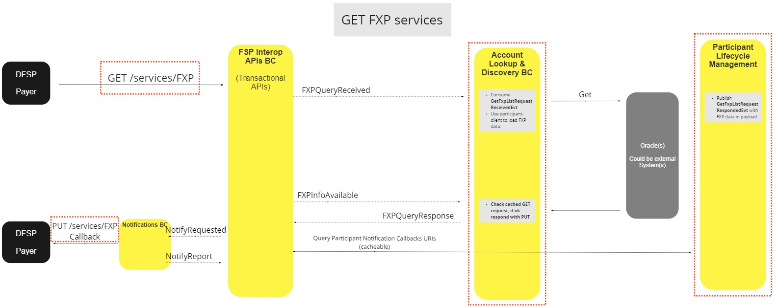
Currency Conversion Phase
Backlog: https://app.zenhub.com/workspaces/mojaloop-project-59edee71d1407922110cf083/issues/gh/mojaloop/project/3737
Backlog: https://app.zenhub.com/workspaces/mojaloop-project-59edee71d1407922110cf083/issues/gh/mojaloop/project/3735

Slide 6
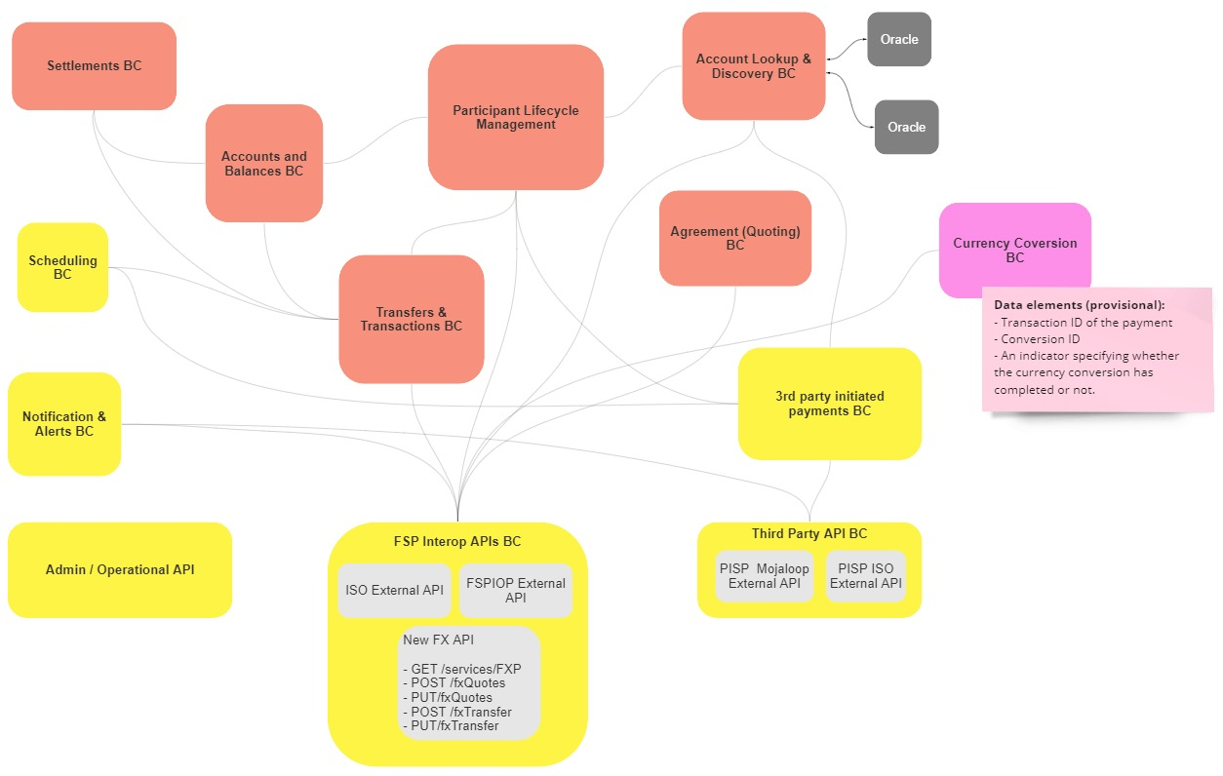
High Level Architecture

Slide 7
High Level Timeline
Agreement Phase
Transfer Phase
Discovery Phase
Currency Conversion
Testing
FEBRUARY
APRIL
Mid January
Estimated ~ 3 to 4 months
JANUARY
MARCH
MAY

Slide 8



Thank you!!!
info@thitsaworks.com
Fb.me/thitsaworks
thitsaworks.com

